Slide 1
PL SQL Conversion

Slide 2
Process
Combined the files
Feed it to Model
Added required Features
Move validation
Interactive game
Test

Slide 3
Prompts
Read the two PL SQL files and create a working Python program using similar functions from the PL SQL program . Do not miss any functionality from the PL SQL code and add comments as needed for easy understanding.
Add move validation logic similar to what the PL SQL files have
create an interactive chess game with the generated code so that two Humans and can play alternate black and white moves to win the game

Slide 4
Game Demo
Bot and Human

Slide 5
Knowledge Base
PL SQL Knowledge Base

Slide 6
Prompt Templates
Epics Read and understand the PL SQL file and create 2 epics that can convert the PL SQL to python micro services in the format with - For, who, the, is a, that, unlike and our solution
Based on the above two epics created, come up with 10 features to convert the PL SQL to Python wiht microservices in mind
Take a core component from the feature and write a Agile story with acceptance criteria

Slide 7
Epic
Epic 1: For: Chess developers and enthusiasts Who: Want to modernize and scale a PL/SQL chess engine The: PL_PIG_CHESS_ENGINE conversion project Is a: Comprehensive effort to transform a monolithic PL/SQL chess engine into Python microservices That: Preserves core chess logic while leveraging cloud-native architectures Unlike: Direct language translations that don't take advantage of modern architectures Our solution: Will involve:Decomposing the engine into separate microservices (e.g., move generation, evaluation, opening book)
Implementing each microservice in Python, optimizing for performance and scalability
Using FastAPI for creating RESTful APIs for each microservice
Deploying microservices in containers for easy scaling and management
Implementing asynchronous communication between microservices using message queues
Replacing PL/SQL-specific constructs with Pythonic equivalents and design patterns
Epic 2: For: Cloud architects and DevOps engineers Who: Need to deploy and manage a distributed chess engine The: PL_PIG_CHESS_ENGINE cloud migration Is a: Project to transform a database-centric chess engine into a cloud-native application That: Enables horizontal scaling and improved maintainability Unlike: Traditional database-bound applications with limited scalability Our solution: Will focus on:Designing a microservices architecture using tools like Kubernetes for orchestration
Implementing a data storage strategy using both SQL and NoSQL databases as appropriate
Creating a CI/CD pipeline for automated testing and deployment of microservices
Developing monitoring and logging solutions for distributed tracing and debugging
Implementing security best practices for microservices, including authentication and authorization
Optimizing network communication between microservices to minimize latency
Providing a unified API gateway for client applications to interact with the distributed chess engine

Slide 8
Features
Move Generation Microservice:
Implement a RESTful API for generating legal moves
Convert PL/SQL move generation logic to Python
Optimize move generation using bitboards
Implement parallelization for move generation
Position Evaluation Microservice:
Create a service for static position evaluation
Port PL/SQL evaluation functions to Python
Implement a machine learning model for evaluation
Provide API endpoints for different evaluation methods
Search Algorithm Microservice:
Implement alpha-beta pruning search in Python
Create API endpoints for different search depths
Utilize multiprocessing for parallel search
Implement iterative deepening and time management
Opening Book Microservice:
Convert PL/SQL opening book to a NoSQL database
Implement API for querying opening moves
Add functionality for book learning and updating
Provide weighted move selection based on statistics
Endgame Tablebase Integration:
Implement Syzygy tablebase probing in Python
Create API endpoints for tablebase lookups
Optimize tablebase access for low latency
Integrate tablebase results into the search algorithm
FEN/EPD Parsing Microservice:
Convert PL/SQL FEN/EPD parsing functions to Python
Implement RESTful API for position setup and export
Add validation and error handling for input formats
Provide conversion between different position representations
Game Management Microservice:
mplement game state management in Python
Create APIs for move application and position updates
Handle special rules (castling, en passant, promotions)
Implement game history and repetition detection
UCI Protocol Interface:
Develop a Python-based UCI protocol handler
Create a gateway service to interact with chess GUIs
Implement command parsing and response generation
Handle multi-threading for long-running commands
Performance Monitoring and Logging:
Implement distributed tracing across microservices
Create a centralized logging system
Develop performance metrics collection and analysis
Implement auto-scaling based on performance data
API Gateway and Authentication:
Develop an API gateway to route requests to appropriate microservices
Implement authentication and authorization mechanisms
Create rate limiting and request throttling
Provide API documentation and versioning

Slide 9
Story with Acceptance Criteria
As a chess application developer, I want a move-generation microservice So that I can efficiently generate legal moves for any given chess position
Acceptance Criteria:
The microservice should expose a RESTful API endpoint that accepts a chess position in FEN format.
The API should return a list of all legal moves for the given position in standard algebraic notation (SAN).
The move generation should handle all special moves correctly:
Castling (both kingside and queenside)
En passant captures
Pawn promotions
The service should validate the input FEN string and return an appropriate error message for invalid positions.
The API should return moves within 100ms for standard positions and within 500ms for complex positions with many possible moves.
The service should be able to handle concurrent requests, supporting at least 100 requests per second.
The move generation logic should be implemented in Python, optimizing for performance where possible (e.g., using bitboards).
The service should include proper error handling and logging for debugging purposes.
Documentation should be provided, including API usage examples and response formats.
Unit tests should cover at least 90% of the move generation code, including edge cases like checkmate and stalemate positions.

Slide 10
Test case
Feature: Core functions of the Chess Engine
As a user
I want to ensure that the chess engine core functions work correctly
So that moves are validated and the game progresses as expected
Background:
Given the chess game is initialized
Scenario: Initialize the chess board
When the game is started
Then the chessboard should be in the standard starting position
And it should be White's turn
Scenario: Make a valid move
Given it is White's turn
When White makes the move "e2e4"
Then the move should be valid
And the piece should be moved from "e2" to "e4"
And it should be Black's turn
Scenario: Make an invalid move
Given it is Black's turn
When Black tries to make the move "e7e5"
And there is no piece on "e7"
Then the move should be invalid
And it should still be Black's turn
And an error message should be displayed
Scenario: Alternating turns between players
Given it is White's turn
When White makes the move "e2e4"
And it is Black's turn
When Black makes the move "e7e5"
Then the moves should be valid
And it should be White's turn
Scenario: Validate pawn movement
Given it is White's turn
When White makes the move "e2e4"
And it is Black's turn
When Black makes the move "e7e5"
Then the moves should be valid
And the pieces should be moved correctly
Scenario: Invalid knight movement
Given it is White's turn
When White tries to move the knight from "b1" to "b3"
Then the move should be invalid
And it should still be White's turn
Scenario: Valid knight movement
Given it is White's turn
When White moves the knight from "b1" to "c3"
Then the move should be valid
And the piece should be moved from "b1" to "c3"
And it should be Black's turn
Scenario: Game over by checkmate
Given the chess game is in a position that can end in checkmate
When White makes a move that puts Black in checkmate
Then the game should be over
And the result should be "White wins by checkmate"

Slide 11
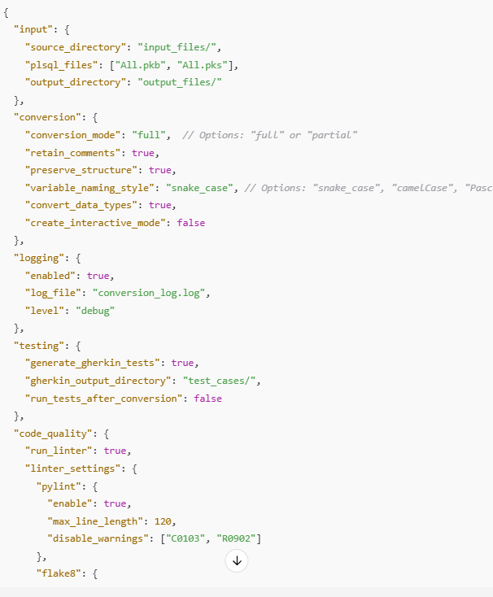
Config file

